Slide 1
National Postal Forum 2024
Overview, Benefits, Testimonies, and More
Cathy Scocco, USPS, Manager, Customer Outreach
Mark Fallon, President, The Berkshire Company
Suzi Oswald, Postal Affairs Specialist and Data Services, SeaChange
Neal Fedderman, Senior Manager, Parcel and Mail Operations, CarMax Business Services
April 4, 2024
Notes:
Welcome everyone
Introductions

Slide 2
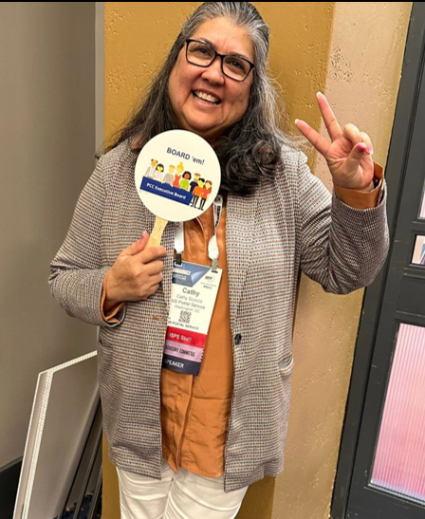
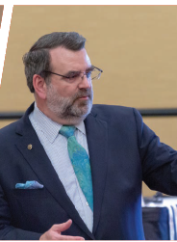
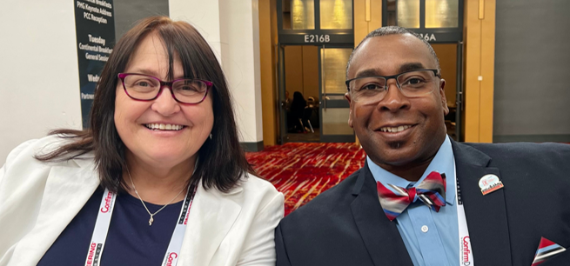
Welcome to National Postal Forum 2024
Overview, Benefits, Testimonies, and More

Slide 3
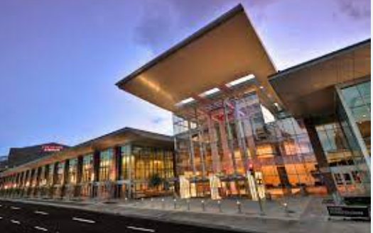
National Postal Forum will be held June 2-5, 2024, in Indianapolis, IN at the Indiana Convention Center. Some of our key features are:
Monday – PMG Keynote Address
Tuesday – Officers General Session
Wednesday – PMG Town Hall with Q & A Session
Leadership Insight Sessions (Formerly Officer Led Sessions)
100+ workshops
Professional Certifications
Exhibit Hall with 130+ vendors
Networking Opportunities including 4 Receptions
Awards Recognition Luncheon

Slide 5
Snapshot of supply chain participants that attend:
Major Mailers
Equipment Manufacturers
Presort Companies
Direct Mail Companies
Transactional Print & Mail Companies
Envelope Manufacturers
Paper Companies
Software Companies
Printers
Insurance Companies
Universities and Colleges
Industry Trade Associations
Shippers
Catalogers

Slide 6
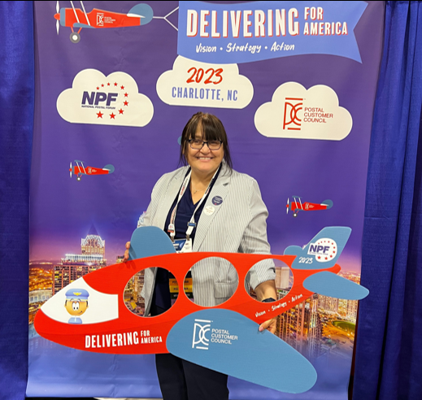
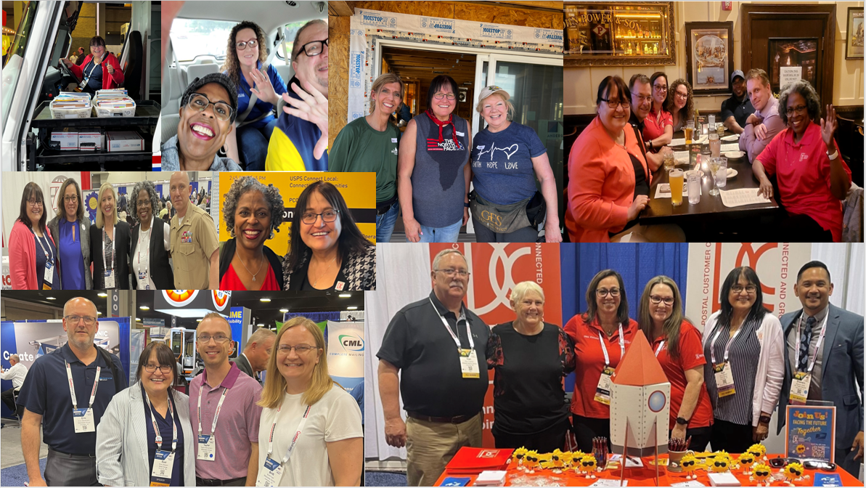
Suzi Oswald
PCC Advisory Committee – Industry Co-Chair, Membership Growth and Recruitment
PCC Industry Chair Twin Cities PCC
Postal Affairs Specialist and Data Services, SeaChange

Slide 7
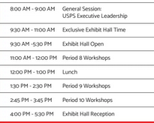
Benefits
Educational
In the Know
Networking
Tips
Study the workshops and exhibit hall
Plan your days
Questions – attend the Peer-to-Peer event
Report back to your company
Have Fun

Slide 8
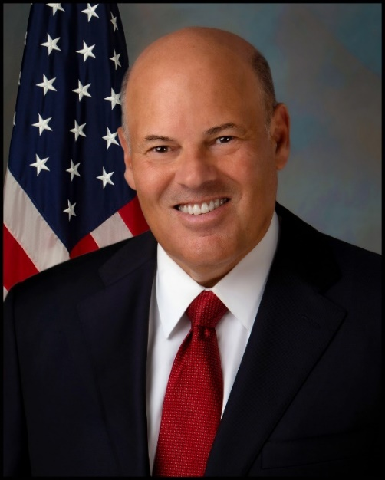
Monday – PMG Keynote
Delivering for America Updates
Opportunities
Challenges
Future State
Tuesday – USPS Officers General Session
Leadership Team will focus on how customers can use our new network and our improved products that are in development
8 Leadership Insight Sessions (Formerly Officer Led Sessions)
Wednesday – PMG Town Hall
Q & A Session
2024PMGTOWNHALL@USPS.GOV

Slide 9
6 Workshop Tracks: 100+ workshops
Pioneering the Future; Innovative Data Technology Solutions – Data and Technology continue to drive informed business decisions. This track will focus on the latest data tools at your disposal to drive better visibility, on-time performance, and customer satisfaction. We’ll explore the latest technology trends and discuss how to effectively implement them into your shipping or mailing operation.
Growing the Mail Through Innovation – If you want to learn about the latest incentives and promotions from the Postal Service, then this track is for you. Mail is still a vital component of any omnichannel campaign, and this track will show you how to utilize mail creatively and effectively to maximize your marketing spend. We’ll look toward the future and explore how mail will evolve and change to suit customers habits
Designing Shipping Solutions for a Competitive Edge – This track specializes in shipping business solutions to drive long-term growth. A focus will be on USPS Ground Advantage, a game changer ground product for fast and reliable delivery. You will hear the latest trends in the industry and learn why the market is still experiencing rapid growth with ever-changing customer needs.

Slide 10
Workshop Tracks continued
Operations Efficiency from Mailing Preparation to Delivery – Preparation is the key to success. Before a customer receives a showstopping mailpiece or a perfectly prepared package, there is a lot of planning that goes on behind the scenes to create THE mail/package moment. This track will focus on best practices for mail/package preparation and entry standards. We’ll cover the programs and applications available to you to ensure your mailpiece or package makes it to its final destination in the most cost-effective way.
Supplier Connections: Supply Chain and Transportation Strategies for Success – This new NPF track designed specifically for current and potential suppliers, provides companies the most current information on commodity specific business practices and contracting opportunities for working with the USPS. Suppliers can select from a series of specialized workshops and interactive sessions with Supply Management, Transportation Strategy, and Fleet Management and Facilities leadership. Suppliers will hear about comprehensive changes and new strategies needed to improve their company’s competitive position and meet USPS supply chain needs.
Leadership Strategies for Professional Enrichment – There is direct correlation between great leadership and high performing organizations but to become an extraordinary leader, you need to practice. This track focuses on your personal development including how to take the lead and get others to follow you, the importance of diversity on your team, understanding the framework for leadership and much more. You’ll walk away with new skills to advance your career.

Slide 11
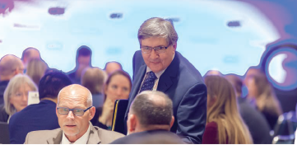
Peer-to-Peer
Opportunity to speak with Industry Peers and USPS Leaders in a round table format
Over 15 tables with different mailing/shipping topics
Traditional Peer-to-Peer table topic discussions include:
Seamless Acceptance
Package Platform
Business Mail Entry Methods
Mailing Promotions
Addressing and more…
Tuesday, June 4
2:45 to 3:45 PM
PROMOTIONS
UPDATES

Slide 12
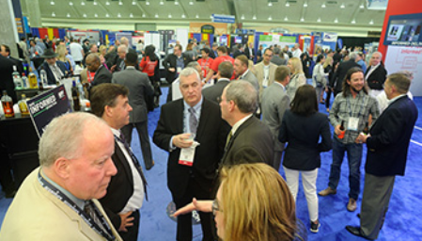
Receptions
Sunday Night – Welcome Reception – 5:30 to 7:00 PM
Indiana State Museum
Monday Night – PCC Reception – 5:30 to 7:00 PM
JW Marriott Grand Ballroom
Tuesday Night – Exhibit Hall Reception – 4:00 to 5:30 PM
Indiana Convention Center
Hall A, B, and C
Wednesday Night – Closing Event – 7:00 to 10:00 PM
Indiana Roof Ballroom
PROMOTIONS
UPDATES

Slide 13
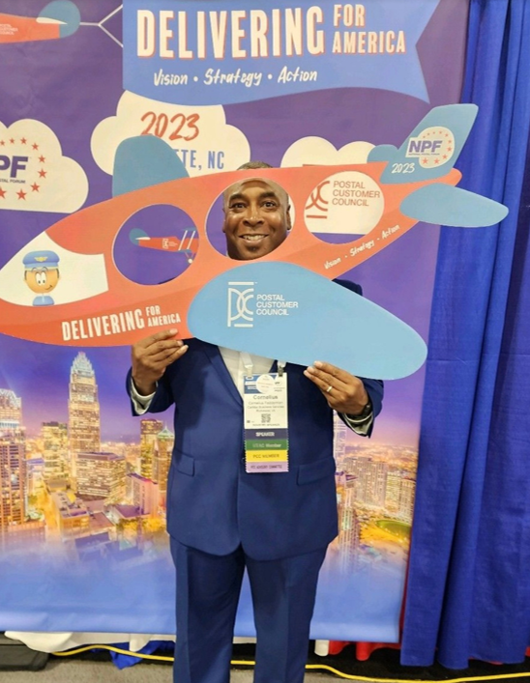
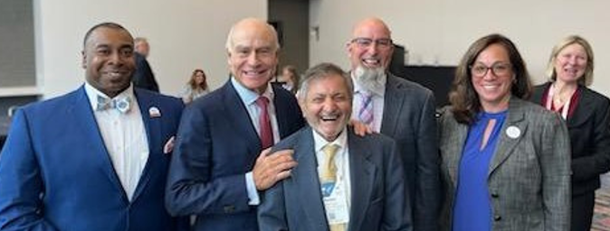
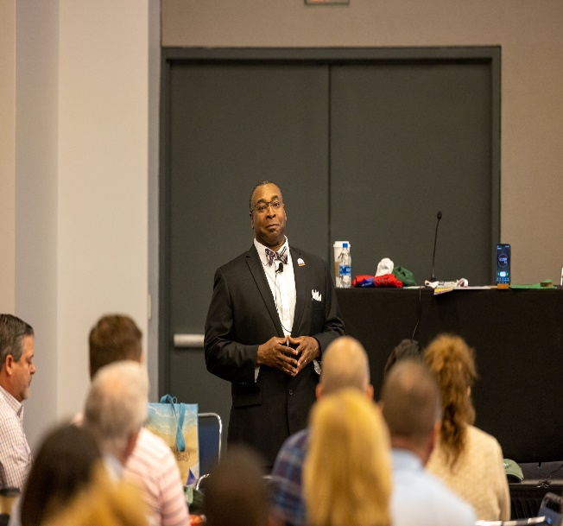
Neal Fedderman
PCC Advisory Committee, National Industry Chair
Member of the Central Virginia PCC
Senior Manager, Parcel and Mail Operations, CarMax Business Services
PROMOTIONS
UPDATES

Slide 14
PCCAC Booth and PCC Welcome Booth (hosted by the Central Indiana PCC)
Volunteers are needed to work shifts
Email James Stotts Jr at James.E.Stotts@usps.gov
PCC General Session
Sunday, June 2 from 4 to 5 PM in the Wabash Room # TBD
Featuring our PCC Leadership Awards
PCC Reception
Monday, June 3 from 5:30 to 7 PM
JW Marriott Grand Ballroom
PCC Boot Camp
Monday, June 3, Period 4 and 6*
Must attend both sessions to qualify for Credly badge
*subject to change
PROMOTIONS
UPDATES

Slide 15
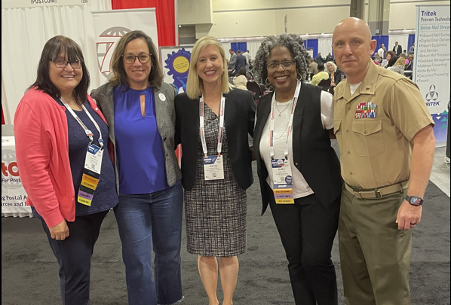
Exhibit Hall
133 Exhibitors – We are Sold Out!
Days/Hours
Monday, 9:30 AM to 4:00 PM
Tuesday, 9:30 AM to 5:30 PM (Includes Reception)
USPS – Sales Booth
Both Vehicles
Next Generation Delivery Vehicle
Ford e-Transit Cargo Van
Charging Stations
Smart Lockers and Rapid Drop-off Station
Consultation Center – Speak with Subject Matter Experts (Need to schedule appointment) – Cynthia.E.Doty@usps.gov
Learning Lab – Retail Modernization
US Postal Inspection Service – USPIS Mobile Command Unit, Informative Publications, giveaways
PCC and MTAC Booths – Stop by to learn more on how to join (Mailing Industry Resource Pavilion)

Slide 16
Delivering for America Partnership for Excellence Awards Luncheon
USPS Honors and Recognizes the best-in-class:
Shipping
Mailing
Transportation
Supplier
Business guest Speaker
S
UPDATES

Slide 17
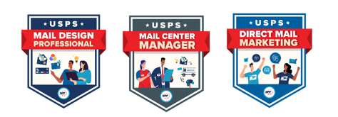
Certifications
Mail Design Professional – Provides in-depth training on postal standards related to designing eye catching letter and flat mail to facilitate processing on high-speed automation equipment while maximizing cost effectiveness and reducing processing delays. All workshops will be held on Tuesday and Wednesday. Two-year Certification.
Direct Mail Marketing – Explore the customer journey and how you can tailor your direct mail to stand out amongst other messaging. All workshops will be held all four days. Attend 7 workshops. Credly badge.
Mail Center Manager – Will teach you the valuable skills needed to manage more effectively, boost productivity, and cut costs. All workshops will be held on Wednesday. Attend 5 workshops. Credly badge.
Credly Badge – Digital credential that recognizes achievement
PROMOTIONS
UPDATES

Slide 18
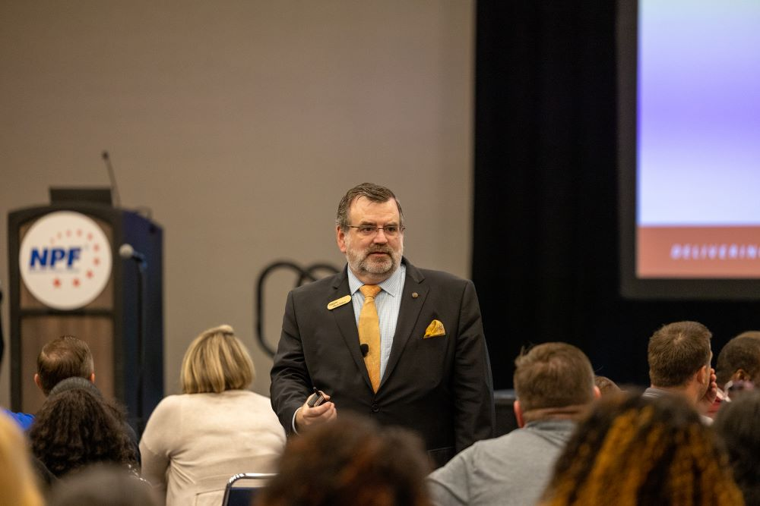
Mark Fallon
Member of the Greater Boston PCC
President, The Berkshire Company
PROMOTIONS
UPDATES

Slide 19
Mail Center Manager Certification
Will teach you the valuable skills needed to manage more effectively, boost productivity, and cut costs. All workshops will be held on Wednesday. Attend 5 workshops. Credly badge
Wednesday, June 5
Period 11 Grow Through the Power of Connections
Period 12 Grow Through Expanding Your Team
Period 13 Grow and Add Value to Your Employer
Period 14 Grow Through Self-Branding
Period 15 Grow Through Self-Actualization
PROMOTIONS
UPDATES

Slide 20
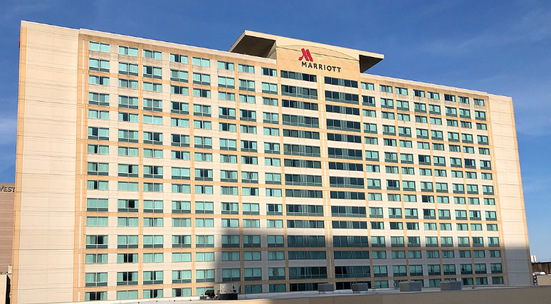
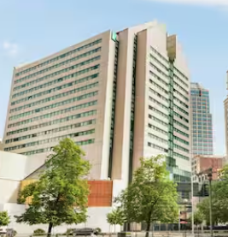
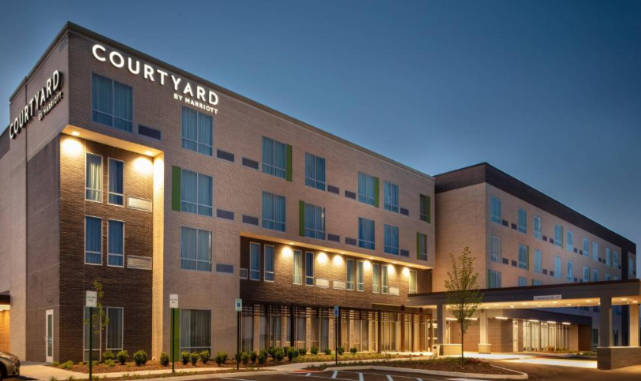
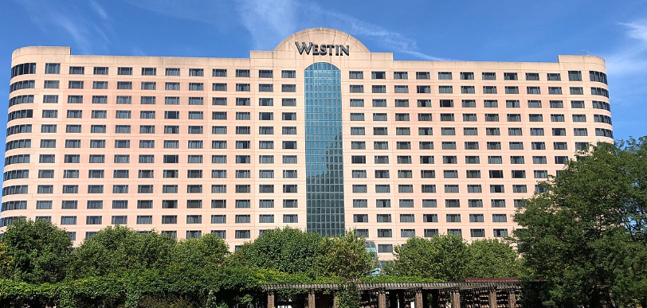
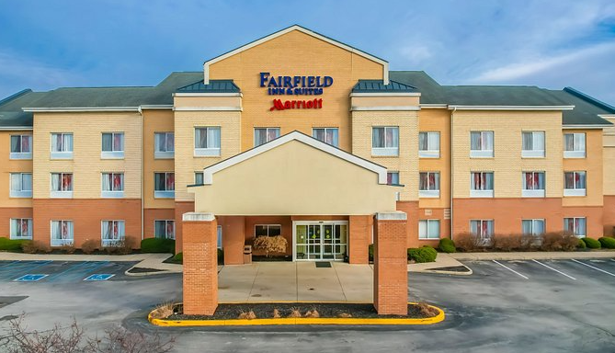
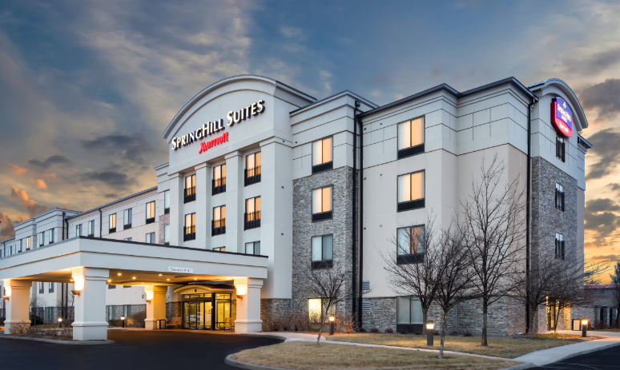
Hotels – Rooms available through the NPF Website
Indianapolis Marriott Downtown
Westin Indianapolis
Courtyard by Marriott
Springhill Suites by Marriott
Fairfield Inn & Suites by Marriott
Embassy Suites
PROMOTIONS
UPDATES

Slide 21
Registration is still open – Register at: https://npf.org
Discounts are available
More information – NPFFEEDBACK@USPS.GOV
PROMOTIONS
UPDATES

